Slide 1
Building an SQL Query Repository
Leigh Duncan
2017 OH-IUG

Slide 2
Goals
Work with Library Staff to determine information needs
Look at current reporting processes and decide what could be automated or improved
Study the Sierra DNA to learn the new information available
Work with Library Web Developers to create queries and make information available to staff

Slide 3
Reality
Create Lists, Statistics, Circulation Reports seen as adequate for Library Staff information needs
Little is reported regularly from Sierra beyond Circulation and Acquisitions Reports
E-Resource reporting comes from other sources
Limitations in the SierraDNA negated some ideas
We needed a “question” before crafting a “solution”

Slide 4
First Steps
2014 - 2016:
Attended Innovative’s workshop “Getting Started with Sierra Direct SQL Access”
Downloaded and configured pgAdmin to access Sierra SQL
Downloaded some IUG presentations
Had good intentions . . . and that’s about it . . .

Slide 5
Catalysts
Over time, “questions” were asked and needs were presented
I took an online Introduction to SQL class to familiarize myself with structuring queries
We purchased Navicat for PostgreSQL
Prolific sharing of queries on the Sierra list and IUG Forum

Slide 6
Navicat and pgAdmin
Both listed on the PostgreSQL website (postgresql.org) list of Administration/Development Tools
Both provide a graphical administrative interface and SQL query tool
We chose Navicat for the user-friendly interface and the ability to share queries via the cloud option; this allows for easy collaboration among staff

Slide 7
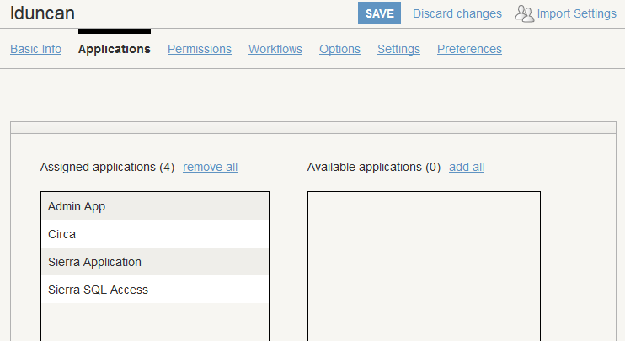
Navicat Setup
Follow the instructions in the manual: Sierra Direct SQL Access > Getting Started
In Sierra Admin, assign the user Sierra SQL Access under Applications

Slide 8
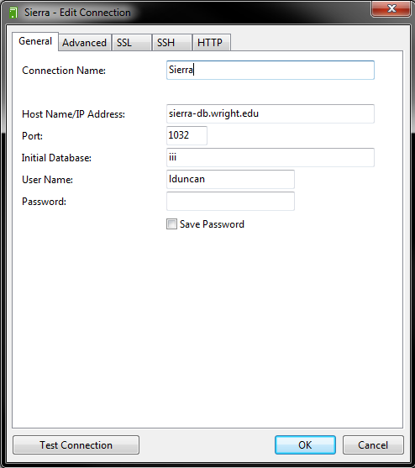
Navicat Setup
Create a Connection within Navicat
Verify that port 1032 is open between your computer and the database server
Check the Troubleshooting page in the manual for additional information

Slide 9
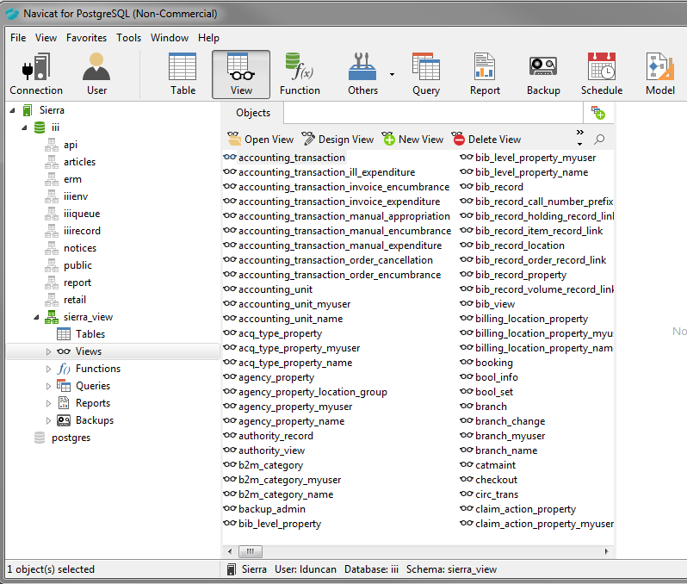
Navicat – Sierra Views
Browse the Sierra Views:

Slide 10
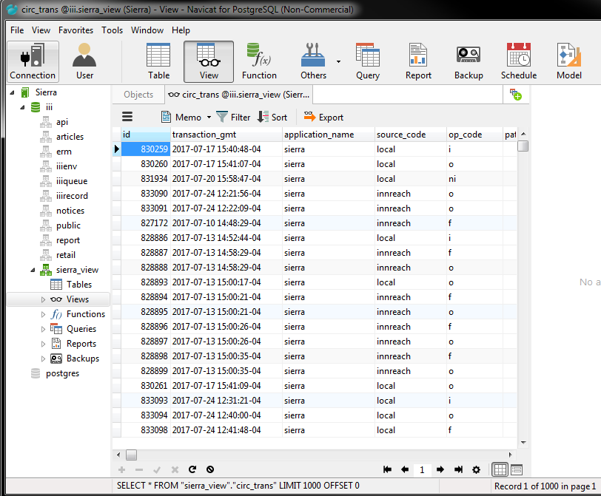
Navicat – Sierra Views
Examine the fields and data:

Slide 11
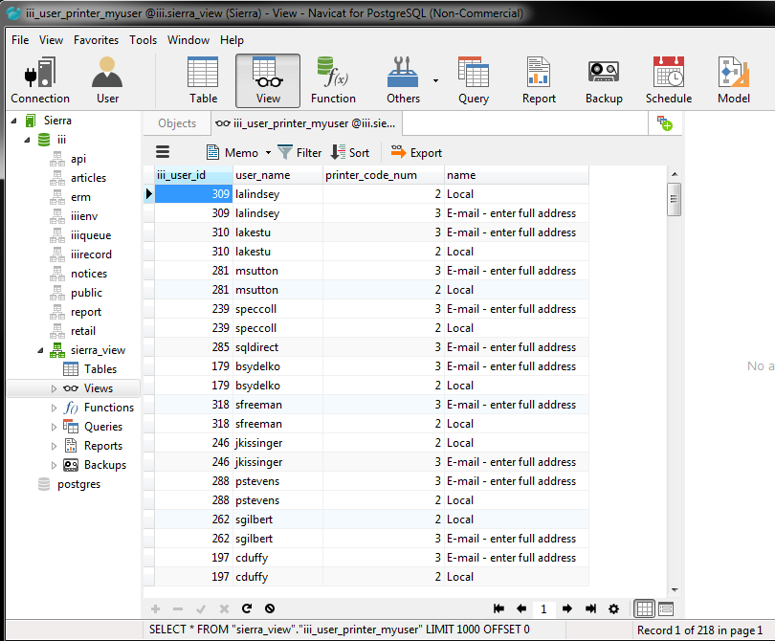
Navicat – Sierra Views
Easily export the data in a variety of formats:

Slide 12
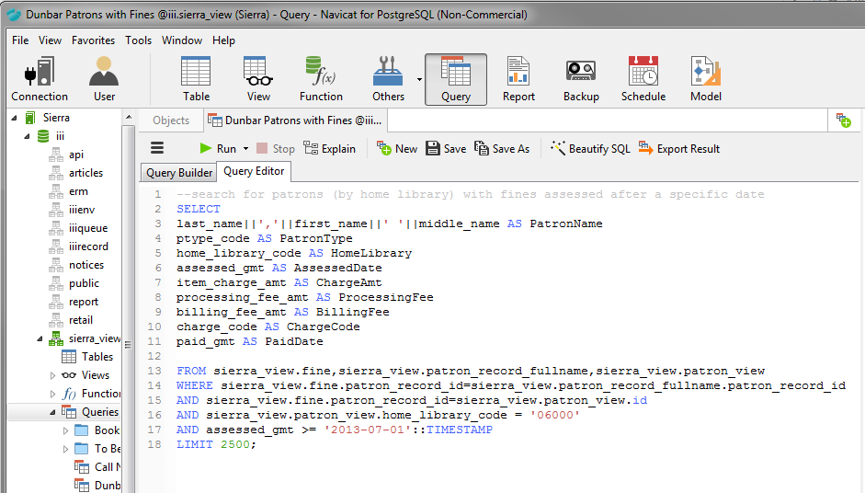
Navicat – Queries
Use the Query Editor to edit existing queries:

Slide 13
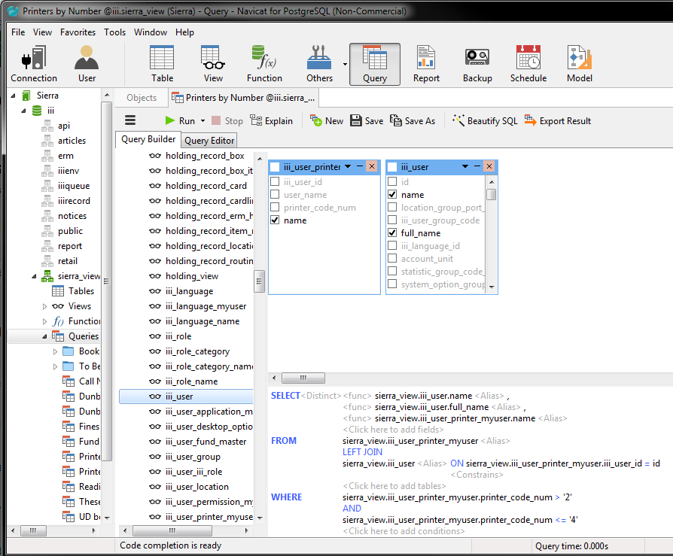
Navicat – Queries
Use the Query Builder to create a new query:

Slide 14
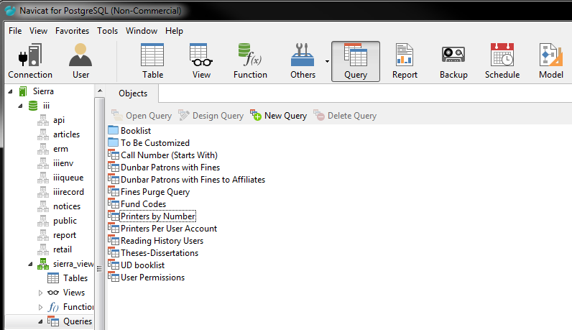
Navicat – Queries
Save your queries and group in folders:

Slide 15
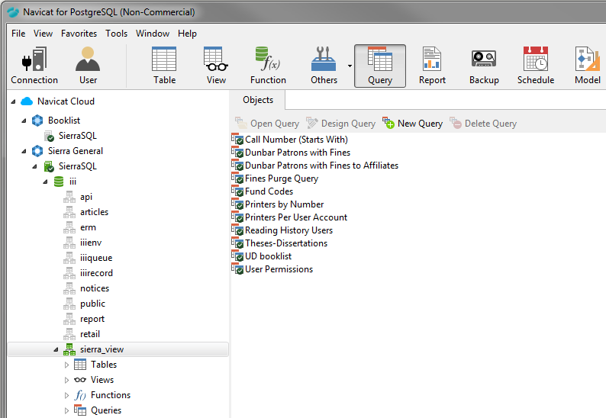
Navicat – Queries
Share in the Navicat Cloud for collaboration

Slide 16
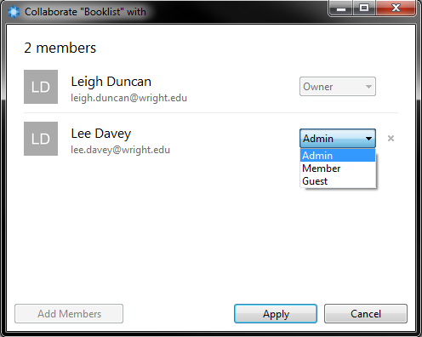
Navicat – Queries
Invite collaborators as Administrators, Members, or Guests

Slide 17
Collecting Queries
Where to find existing queries:
Sierra Listserv:
http://listserv.iii.com/read/?forum=sierra
IUG Clearinghouse:
http://innovativeusers.org/resources/clearinghouse.html
IUG Forums:
http://innovativeusers.org/index.php/iug-forum/sierra-millennium-encore.html
IUG Presentations:
http://innovativeusers.org/index.php/conferences/search-presentations.html
Sierra Manual examples:
Sierra Direct SQL Access > Query Examples

Slide 18
Collecting Queries
Would the data collected by the query be useful for my library?
Determine which staff would use the information and ask if they want further customizations
Copy the query and paste it into the Query Editor in Navicat
Save in the To Be Customized folder

Slide 19
Customizing Queries
Copy and paste the existing query into the Query Editor
Replace library-specific data, such as location codes or user names:

Slide 20
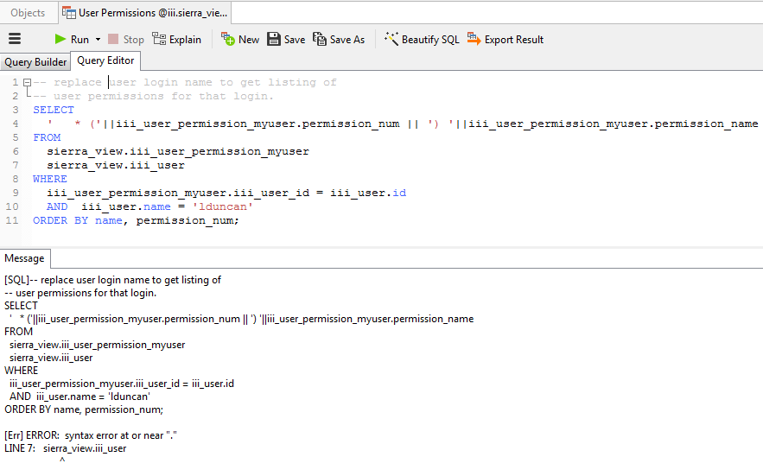
Customizing Queries
Run the query and look for errors:
Message shows an error near Line 7 . . . Upon inspection, there is a missing comma at the end of Line 6

Slide 21
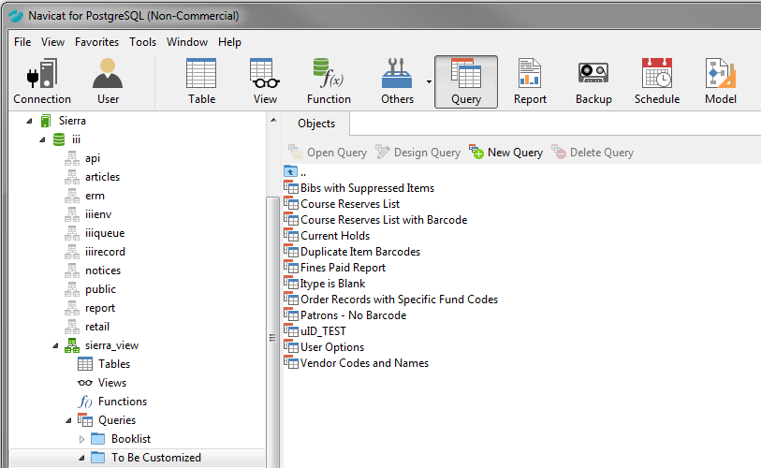
So Much Work . . . So Little Time
The “To Be Customized” folder . . . waiting for you when you have time to investigate and play

Slide 22
Example: User Permissions
Back in the day . . . User Permissions could be printed per user from the character-based system
The following query allows you to get a list of User Permissions per user
Results can be viewed or exported as needed

Slide 23
Example: User Permissions
SELECT
' * ('||iii_user_permission_myuser.permission_num || ') '||iii_user_permission_myuser.permission_name
FROM
sierra_view.iii_user_permission_myuser
sierra_view.iii_user
WHERE
iii_user_permission_myuser.iii_user_id = iii_user.id
AND iii_user.name = 'lduncan'
ORDER BY name, permission_num;

Slide 24
Example: WebPac Reading History
Question from our Public Services staff: How many users really opt in to the Reading History feature in our web catalog?
SELECT is_reading_history_opt_in, COUNT(*)
FROM sierra_view.patron_record
WHERE expiration_date_gmt>=CURRENT_TIMESTAMP
GROUP BY is_reading_history_opt_in;

Slide 25
Example: Printers by User Login
Project
Our campus was moving to a managed printing system, which required me to rework which printers were assigned to user logins in Sierra
Option 1: Open each user account manually to record which printers are assigned
Option 2: Find/create a query that lists printers assigned to user logins

Slide 26
Example: Printers by User Login
SELECT
user_name AS Login,
printer_code_num AS PrinterNumber,
name AS PrinterName
FROM sierra_view.iii_user_printer_myuser
LIMIT 150;

Slide 27
Example: Fines Purged
Project
Quarterly, we purge patron fines from Sierra, and transfer the charges to our Bursar Department. There is a Fines Paid report, but our Circulation Department needed additional information about the fines that were transferred.
The following query is used, with the date being changed to the date of the Fines Transfer

Slide 28
Example: Fines Purged
SELECT
checked_out_date_gmt AS CheckedOut,
due_date_gmt AS DueDate,
fine_assessed_date_gmt AS DateAssessed,
last_name||','||first_name||' '||middle_name AS PatronName,
barcode AS PatronBarcode,
record_num AS RecordNumber,
invoice_num AS Invoice,
item_charge_amt AS ChargeAmount,
processing_fee_amt AS ProcessingFee,
billing_fee_amt AS BillingFee,
CAST(paid_date_gmt AS DATE) as TransferDate,
charge_type_code AS ChargeType,
description AS Title,
location_code AS ItemLocation

Slide 29
Example: Fines Purged
FROM sierra_view.fines_paid,
sierra_view.patron_record_fullname,
sierra_view.patron_view,
sierra_view.item_record
WHERE sierra_view.fines_paid.patron_record_metadata_id=sierra_view.patron_record_fullname.patron_record_id
AND sierra_view.fines_paid.patron_record_metadata_id=sierra_view.patron_view.id
AND sierra_view.fines_paid.item_record_metadata_id=sierra_view.item_record.record_id
AND paid_date_gmt >= '2017-08-14'::TIMESTAMP
LIMIT 800;

Slide 30
Example: Patron Fines by Home Library
Project
Following an audit, the question arose as to how much money Wright State patrons owe to the Wright State University Libraries (as opposed to fines owed to our affiliated libraries, which share our Sierra system)
The following query searches for patron, by home library, with fines assessed for a specific library, after a specified date

Slide 31
Example: Patron Fines by Home Library
SELECT
last_name||','||first_name||' '||middle_name AS PatronName,
ptype_code AS PatronType,
home_library_code AS HomeLibrary,
assessed_gmt AS AssessedDate,
item_charge_amt AS ChargeAmt,
processing_fee_amt AS ProcessingFee,
billing_fee_amt AS BillingFee,
charge_code AS ChargeCode,
paid_gmt AS PaidDate
FROM sierra_view.fine,sierra_view.patron_record_fullname,sierra_view.patron_view
WHERE sierra_view.fine.patron_record_id=sierra_view.patron_record_fullname.patron_record_id
AND sierra_view.fine.patron_record_id=sierra_view.patron_view.id
AND sierra_view.patron_view.home_library_code = '06000'
AND assessed_gmt >= '2013-07-01'::TIMESTAMP
LIMIT 2500;

Slide 32
Next Steps
Continue adding queries to the repository
Currently there are 17 query examples in my inbox that need to be evaluated and customized
Think beyond staff use . . .
How can we leverage Sierra data for patron use?
In the process of upgrading our monthly New Book and Media List
Train additional staff to use Navicat to edit and run existing queries

Slide 33
Questions?
Leigh Duncan
leigh.duncan@wright.edu
(937) 775-2570

